Slide 1

Capstone Project- Classification
Bank Marketing Effectiveness Prediction
By
Manmohan Madhu

Slide 2
Predicting the outcome of a telemarketing call campaign
Import data and libraries
EDA
Feature engineering
Machine learning
Evaluation metrics
Conclusion

Slide 3
Dataset
Independent variables | age | housing | duration
 | job | loan | campaign
 | marital | contact | pdays
 | education | month | previous
 | default | day_of_week | poutcome
Dependent variable | y

Slide 4
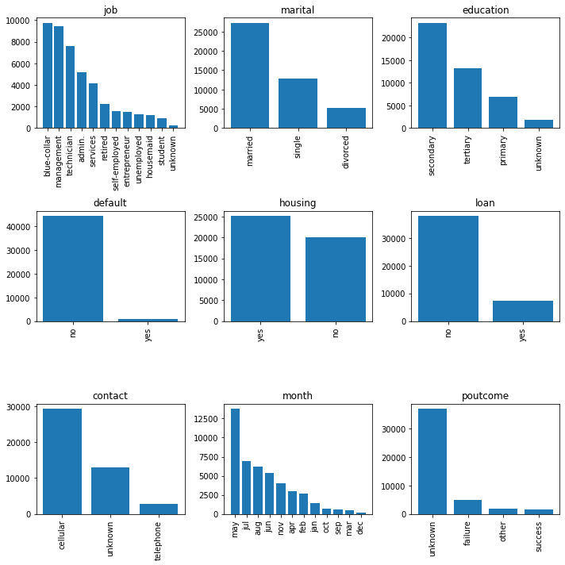
Exploratory Data Analysis
Univariate analysis
(Categorical variables):

Slide 5
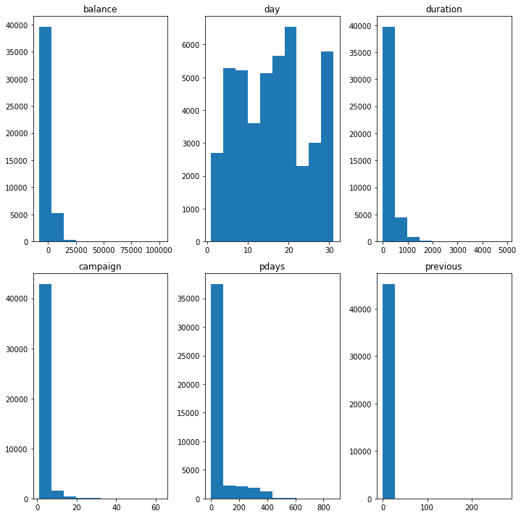
Exploratory Data Analysis
Univariate analysis
(Numerical variables):

Slide 6
Outliers
Column pdays had more than half of its values as negative 1 which made no sense as days cannot be negative and hence it was dropped.
Entries for columns campaign and previous which were above 34 were replaced with their mean as these were outliers inferred from their distribution plots.

Slide 7
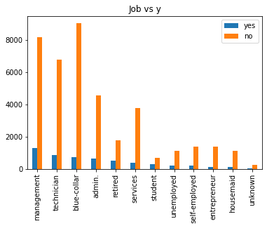
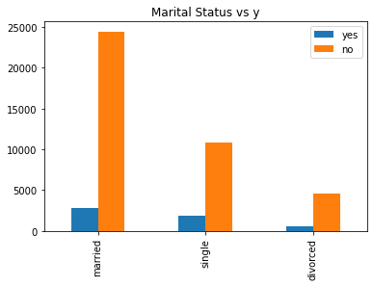
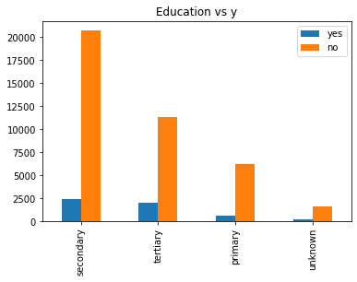
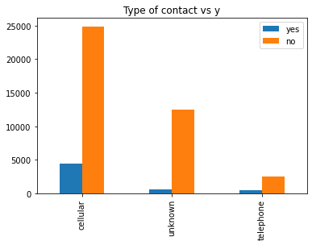
Exploratory Data Analysis
Bivariate analysis

Slide 8
Findings from EDA
Customers working blue collar jobs are less likely to subscribe whereas management and technicians are more likely.
Single customers are more likely to subscribe for a term deposit whereas married customers are less likely.
Customers with tertiary education are more likely to subscribe whereas customers with secondary education are less likely to subscribe.

Slide 9
Feature Engineering
Replacing yes or no with boolean values.
Replacing with mean if the value is more than a specified threshold..
One hot encoding of categorical columns.

Slide 10
Machine Learning using XGBoost and Random Forest Classifier
For test data(in%) | Accuracy | Roc_auc
XGBoost | 90.6 | 71.66
Random Forest Classifier | 89.53 | 90.88

Slide 11
Conclusion
With an accuracy of 89.5 percent and an roc_auc score of 90.88 percent we can confidently use this model to predict whether the customer will subscribe or not even before the call is made. This will save time and resources as we have to only call the customers who are more likely to subscribe thereby reducing the workload of the marketing team.

